Slide 1

Object Oriented Programming
Introduction to Java

Slide 2




About me - Dr. Hai Tran

Slide 3

Initial– Find a group
Small group
Group Leader
Name, icon, SLOGAN
Notes:
3 group

Slide 4
Acknowledgement
The contents of these slides have origin from School of Computing, National University of Singapore.
We greatly appreciate support from Mr. Aaron Tan Tuck Choy, and Dr. Low Kok Lim for kindly sharing these materials.
4

Slide 5
Policies for students
These contents are only used for students PERSONALLY.
Students are NOT allowed to modify or deliver these contents to anywhere or anyone for any purpose.
5

Slide 6




C →
Java
Objectives
Java
Basic Java features
Translate C programs in 501042 into Java programs
[501043 Lecture 1: Intro to Java]
6

Slide 7
Outline
Java: Brief history and background
Run cycle
Basic program structure
Basic Java elements
  Arithmetic Expressions
  Control Flow Statements and Logical Expressions
  Basic Input (Scanner class) and Output
  API
  Math class, Class Attributes
  User-defined Functions
[501043 Lecture 1: Intro to Java]
7

Slide 8

1. Java: Brief History & Background
James Gosling
1995, Sun Microsystems
Use C/C++ as foundation
“Cleaner” in syntax
Less low-level machine interaction
Write Once, Run EverywhereTM
Extensive and well documented standard library
Less efficient

Slide 9












Recap: Process
2. Run Cycle
Writing
Compiling
Executing
Tool: Editor
Produce:
Source Code
Tool:
Compiler
Produce: Executable Bytecode
Tool:
None
Produce:
Result
Compilation Error
Runtime Error Logic Error

Slide 10
Recap: Run Cycle for C Programs
2. Run Cycle
Writing/Editing Program
  Use an editor, e.g.: vim
  Source code must have a .c
extension
vim welcome.c
welcome.c
Compiling Program
  Use a C compiler, eg: gcc
  Default executable file: a.out
Executing Binary
  Type name of executable file
gcc -Wall welcome.c
a.out
a.out
output

Slide 11
Java: Compile Once, Run Anywhere?
2. Run Cycle
Normal executable files are directly dependent on the OS/Hardware
  Hence, an executable file is usually not executable on different platforms
  E.g: The a.out file compiled on sunfire is not
executable on your Windows computer
Java overcomes this by running the executable on an uniform hardware environment simulated by software
  The hardware environment is know as the Java Virtual Machine (JVM)
  So, we only need a specific JVM for a particular platform to execute all Java bytecodes without recompilation

Slide 12
Run Cycle for Java Programs
2. Run Cycle
Writing/Editing Program
  Use an text editor, e.g: vim
vim HelloWorld.java
Source code must have .java extension
HelloWorld.java
Compiling Program
  Use a Java compiler, e.g.: javac
  Compiled binary has .class extension
  The binary is also known as Java
Executable Bytecode
javac HelloWorld.java
HelloWorld.class
Executing Binary
  Run on a Java Virtual Machine (JVM)
    e.g.: java HelloWorld
(leave out the .class extension)
  Note the difference here compared to C executable
java HelloWorld
output
[501043 Lecture 1: Intro to Java] 13

Slide 13
Java Execution Illustration
2. Run Cycle
a.out
Normal executable (e.g.: C programs) are tied to a specific platform (OS + Hardware) This a.out cannot work in a machine of different architecture.
Windows 7 on Core 2
HelloWorld.class
JVM provides a uniform environment for Java bytecode execution.
Java Virtual Machine
Windows 7 on Core 2
They are the same portable file.
HelloWorld.class
Java Virtual Machine
MacOS on PowerPC

Slide 14
3. Basic Java Program Structure
Today: just the basic language components:
  Basic Program Structure
  Primitive data types and simple variables
  Control flow (selection and repetition statements)
  Input/output statements
Purpose: ease you into the language
  You can attempt to “translate” some simple C
programs done in 501042 into Java
We will gradually cover many other Java features over the next few weeks

Slide 15


Hello World!
3. Basic Structure
C
#include <stdio.h>
int main(void) {
printf("Hello World!\n");
return 0;
}
HelloWorld.
c
import java.lang.*; // optional public class HelloWorld {
Java
Beginners’ common mistake:
Public class name not identical to program’s file name.
public static void main(String[] args) { System.out.println("Hello World!");
}
}
HelloWorld.java

Slide 16
When you see this icon at the top right corner of the slide, it means that in the interest of time the slide might be skipped over in lecture and hence is intended for your own reading.
[501043 Lecture 1: Intro to Java] 17

Slide 17

Key Observations (1/2)
3. Basic Structure
Library in Java is known as package
  Packages are organized into hierarchical grouping
  E.g., the “System.out.println()” is defined in the “java.lang.System”
    i.e. “lang” (language) is a package under “java” (the
main category) and “System” is a class under “lang”
To use a predefined library, the appropriate package should be imported:
  Using the “import XXXXXX;” statement
  All packages under a group can be imported with a “*” (the wildcard character)
Packages under “java.lang” are imported by default
  Hence, the import statement in this example is optional
[501043 Lecture 1: Intro to Java] 18

Slide 18
Key Observations (2/2)
3. Basic Structure
The main() method (function) is now enclosed in a “class”
  More about class will be explained in lecture 2
  There should be only one main() method in a program,
which serves as the execution starting point
  A source code file may contain one or more classes
    There are restrictions which will be explained later – this is a bit
too advanced at this point
    For the moment, we will restrict ourselves to one class per source code
  Each class will be compiled into a separate XXXX.class
bytecode
    The “XXXX” is taken from the class name (“HelloWorld” in this example)
[501043 Lecture 1: Intro to Java] 19

Slide 19
4.1 Arithmetic Expressions

Slide 20
4.1 Identifier, Variable, Constant (1/2)
Identifier is a name that we associate with some program entity (class name, variable name, parameter name, etc.)
Java Identifier Rule:
  May consist of letters (‘a’ – ‘z’, ‘A’ – ‘Z’), digit characters (‘0’ – ‘9’), underscore (_) and dollar sign ($)
  Cannot begin with a digit character
Variable is used to store data in a program
  A variable must be declared with a specific data type
Eg:
int countDays;
double priceOfItem;

Slide 21
4.1 Identifier, Variable, Constant (2/2)
Constant is used to represent a fixed value
Eg:
public static final int PASSING_MARK = 65;
Keyword final indicates that the value cannot change
Guidelines on how to name classes, variables, and constants: see 501043 website → Resources → Online:
  http://sakai.it.tdt.edu.vn
  Class name: UpperCamelCase
    Eg: Math, HelloWorld, ConvexGeometricShape
  Variable name: LowerCamelCase
    Eg: countDays, innerDiameter, numOfCoins
  Constant: All uppercase with underscore
    Eg: PI, CONVERSION_RATE, CM_PER_INCH

Slide 22
4.1 Numeric Data Types
Summary of numeric data types in Java:
Type Name | Size (#bytes) | Range
byte | 1 | -2⁷ to 2⁷-1
short | 2 | -2¹⁵ to 2¹⁵-1
int | 4 | -2³¹ to 2³¹-1
long | 8 | -2⁶³ to 2⁶³-1
float | 4 | Negative: -3.4028235E+38 to -1.4E-45 Positive: 1.4E-45 to 3.4028235E+38
double | 8 | Negative: -1.7976931348623157E+308 to -4.9E-324 Positive: 4.9E-324 to 1.7976931348623157E+308
Integer Data
Types
Floating- Point Data
Types
Unless otherwise stated, you are to use:
  int for integers
  double for floating-point numbers

Slide 23
4.1 Numeric Operators
() | Parentheses Grouping | Left-to-right
++, -- | Postfix incrementor/decrementor | Right-to-left
++, -- +, - | Prefix incrementor/decrementor Unary +, - | Right-to-left
*, /, % | Multiplication, Division, Remainder of division | Left-to-right
+, - | Addition, Subtraction | Left-to-right
= += -= *= /= %= | Assignment Operator Shorthand Operators | Right-to-left
Higher Precedence
Evaluation of numeric expression:
  Determine grouping using precedence
  Use associativity to differentiate operators of same precedence
  Data type conversion is performed for operands with different data type

Slide 24
4.1 Numeric Data Type Conversion
When operands of an operation have differing types:
  If one of the operands is double, convert the other to double
  Otherwise, if one of them is float, convert the other to float
  Otherwise, if one of them is long, convert the other to long
  Otherwise, convert both into int
When value is assigned to a variable of differing types:
Widening (Promotion):
  Value has a smaller range compared to the variable
  Converted automatically
Narrowing (Demotion):
  Value has a larger range compared to the variable
  Explicit type casting is needed

Slide 25
4.1 Data Type Conversion
Conversion mistake:
double d; int i;
i = 31415;
d = i / 10000;
What’s the mistake? How do you correct it?
Q: What is assigned to d?
The (int) d expression is
known as type casting
Syntax: (datatype) value Effect:
value is converted explicitly to
the data type stated if possible.
Type casting:
double d;
int i;
d = 3.14159;
i = (int) d; // i is assigned 3
Q: What is assigned to i if d contains 3.987 instead?

[501043 Lecture 1: Intro to Java] 26

Slide 26
4.1 Problem: Fahrenheit to Celsius
Write a simple Java program Temperature.Java:
  To convert a temperature reading in Fahrenheit, a real number, to Celsius degree using the following formula:
celsius = ⁵ × ( fahrenheit− 32)
9
Print out the result
For the time being, you can hard code a value for the temperature in Fahrenheit instead of reading it from user

Slide 27
4.1 Solution: Fahrenheit to Celsius
public class Temperature {
Temperature.java
public static void main(String[] args) {
double fahrenheit, celsius;
fahrenheit = 123.5;
Output:
Celsius: 50.833333333333336
celsius = (5.0/9) * (fahrenheit – 32);
System.out.println("Celsius: " + celsius);
}
}
Compare with C:
printf("Celsius: %f\n", celsius);
Notes:
  5.0/9 is necessary to get the correct result (what will 5/9 give?)
  “+” in the printing statement
    Concatenate operator, to combine strings into a single string
    Variable values will be converted to string automatically
  There is another printing statement, System.out.print(), which does not include newline at the end of line (more in section 4.3)

Slide 28
4.2 Control Statements
Program Execution Flow

Slide 29
4.2 Boolean Data Type [new in Java]
Java provides an actual boolean data type
  Store boolean value true or false, which are keywords
in Java
  Boolean expression evaluates to either true or false
SYNTAX
boolean variable;
Example | boolean isEven; int input; // code to read input from user omitted if (input % 2 == 0)
 | isEven = true; else | Equivalent: isEven = (input % 2 == 0);
 | isEven = false; if (isEven) System.out.println("Input is even!");

Slide 30
4.2 Boolean Operators
 | Operators | Description
Relational Operators | < | less than
 | > | larger than
 | <= | less than or equal
 | >= | larger than or equal
 | == | Equal
 | != | not equal
Logical Operators | && | and
 | || | or
 | ! | not
 | ^ | exclusive-or
Operands are variables / values that can be compared directly.
Examples:
X < Y
1 >= 4
Operands are boolean variables/expressions.
Examples:
(X < Y) && (Y < Z)
(!isEven)

Slide 31
4.2 Comparison with C
In ANSI C, there is no boolean type.
  Zero means ‘false’ and any other value means ‘true’
int x;
... // assume x is assigned a non-negative value if (x%3)
printf("%d is not divisible by 3.\n", x); else
printf("%d is divisible by 3.\n", x);
In Java, the above is invalid
Java code:
int x;
... // assume x is assigned a non-negative value if (x%3 != 0)
System.out.println(x + " is not divisible by 3.");
else
System.out.println(x + " is divisible by 3.");

Slide 32
4.2 Selection Statements
if (a > b) {
...
}
else {
...
}
if-else statement
  else-part is optional
Condition:
  Must be a boolean expression
  Unlike C, integer values are NOT valid
switch (a) { case 1:
...
break; case 2:
case 3:
...
default:
}
switch-case statement
Expression in switch() must evaluate to a value of char, byte, short or int type
break: stop the fall-through execution
default: catch all unmatched cases;
may be optional
[501043 Lecture 1: Intro to Java] 33

Slide 33
4.2 Repetition Statements (1/2)
Valid conditions:
  Must be a boolean expression
while : check condition before executing body
do-while: execute body before
condition checking
A: initialization (e.g. i = 0)
B: condition (e.g. i < 10)
C: update (e.g. i++)
Any of the above can be empty
Execution order:
  A, B, body, C, B, body, C, …
while (a > b) {
... //body
}
do {
... //body
} while (a > b);
for (A; B; C) {
... //body
}
[501043 Lecture 1: Intro to Java] 34

Slide 34
4.2 Repetition Statements (2/2)
In ANSI C, the loop variable must be declared before it is
used in a ‘for’ loop
int i;
for (i=0; i<10; i++) {
...
}
In Java, the loop variable may be declared in the initialisation
part of the ‘for’ loop
In example below, the scope of variable i is within the ‘for’ loop only
for (int i=0; i<10; i++) {
...
}
[501043 Lecture 1: Intro to Java] 35

Slide 35
4.3 Basic Input/Output
Interacting with the outside world

Slide 36
4.3 Reading input: The Scanner Class
PACKAGE
import java.util.Scanner;
//Declaration of Scanner "variable"
Scanner scVar = new Scanner(System.in);
//Functionality provided
SYNTAX
scVar.nextInt();
Read an integer value from
source System.in
scVar.nextDouble();
Read a double value from source System.in
......
Other data types, to be covered later

Slide 37
4.3 Reading Input: Fahrenheit Ver 2
import java.util.Scanner; // or import java.util.*;
public class TemperatureInteractive { public static void main(String[] args) {
double fahrenheit, celsius;
Scanner sc = new Scanner(System.in);
System.out.print("Enter temperature in Fahrenheit: ");
fahrenheit = sc.nextDouble();
celsius = (5.0/9) * (fahrenheit – 32);
System.out.println("Celsius: " + celsius);
}
}
TemperatureInteractive.java

Slide 38
4.3 Reading Input: Key Points (1/3)
The statement
Scanner sc = new Scanner(System.in);
  Declares a variable “sc” of Scanner type
  The initialization “new Scanner(System.in)”
    Constructs a Scanner object
      We will discuss more about object later
    Attaches it to the standard input “System.in” (which is the keyboard)
      This Scanner object sc will receive input from this source
    Scanner can attach to a variety of input sources; this is
just a typical usage

Slide 39
4.3 Reading Input: Key Points (2/3)
After proper initialization, a Scanner object provides functionality to read value of various types from the input source
The statement
fahrenheit = sc.nextDouble();
  nextDouble() works like a function (called method in Java) that returns a double value read interactively
  The Scanner object sc converts the input into the appropriate data type and returns it
    in this case, user input from the keyboard is converted into a double value

Slide 40
4.3 Reading Input: Key Points (3/3)
Typically, only one Scanner object is needed, even if many input values are to be read.
  The same Scanner object can be used to call the relevant methods to read input values
Note: In CodeCrunch, your program will NOT work if you use more than one Scanner object in your program.

Slide 41
4.3 Writing Output: The Standard Output
System.out is the predefined output device
  Refers to the monitor/screen of your computer
//Functionality provided System.out.print( output_string );
System.out.println( output_string );
System.out.printf( format_string, [items] );
SYNTAX
System.out.print("ABC"); System.out.println("DEF"); System.out.println("GHI");
System.out.printf("Very C-like %.3f\n", 3.14159);
Output:
ABCDEF GHI
Very C-like 3.142

Slide 42
4.3 Writing Output: printf()
Java introduces printf() in Java 1.5
  Very similar to the C version
The format string contains normal characters and a number of specifiers
  Specifier starts with a percent sign (%)
  Value of the appropriate type must be supplied for each specifier
Common specifiers and modifiers:
%[-][W].[P]type
-: For left alignment
W: For width
P: For precision
%d | for integer value
%f | for double floating-point value
%s | for string
%b | for boolean value
%c | for character value
SYNTAX

Slide 43
4.3 Problem: Approximating PI
One way to calculate the PI (π) constant:
π = ⁴ − ⁴ + ⁴ − ⁴ + ⁴ −.........
1 3 5 7 9
  Write ApproximatePI.java to:
    Ask the user for the number of terms to use for approximation
    Calculate π with the given number of terms
    Output the approximation in 6 decimal places

Slide 44
4.3 Solution: Approximating PI
import java.util.*; // using * in import statement
public class ApproximatePI {
public static void main(String[] args) { int nTerms, sign = 1, denom = 1;
double pi = 0.0;
Scanner sc = new Scanner(System.in);
System.out.print("Enter number of terms: ");
nTerms = sc.nextInt();
π = ⁴ − ⁴ + ⁴ − ⁴ + ⁴ −.........
for (int i = 0; i < nTerms; i++) { pi += 4.0 / denom * sign; sign *= -1;
denom += 2;
}
1 3 5 7 9
System.out.printf("PI = %.6f\n", pi);
}
}
ApproximatePI.java

Slide 45
4.4 API
Application Programming Interface

Slide 46

4.4 API (1/2)
The Scanner class you have seen is part of the Java API
  API: an interface for other programs to interact with a program
without having direct access to the internal data of the program
  Documentation, SE7: http://docs.oracle.com/javase/7/docs/api/
  You may also access the above link through 501043 website →
Resources → Online (http://sakai.it.tdt.edu.vn)
  For Java programmers, it is very important to refer to the API documentation regularly!
The API consists of many classes
  You do not need to know all the classes (there are easily a few thousand classes altogether!)
  You will learn some more classes in this course
This week reading assignment
  Read up Scanner class in the API documentation

Slide 47
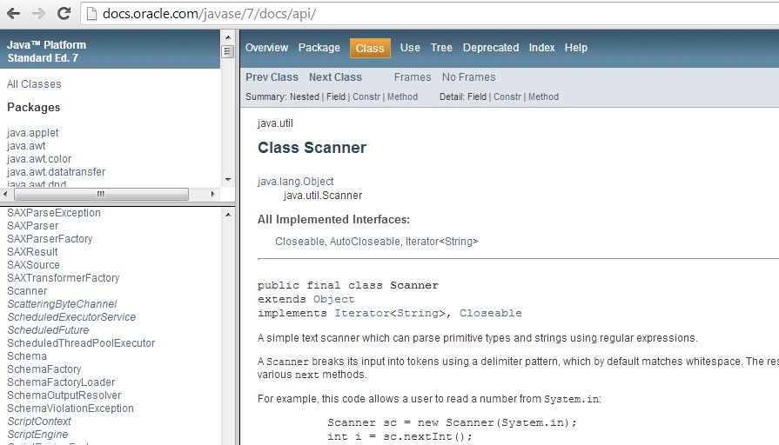
4.4 API (2/2)

Slide 48
4.5 Math class, Class Attributes
Using the Math class

Slide 49
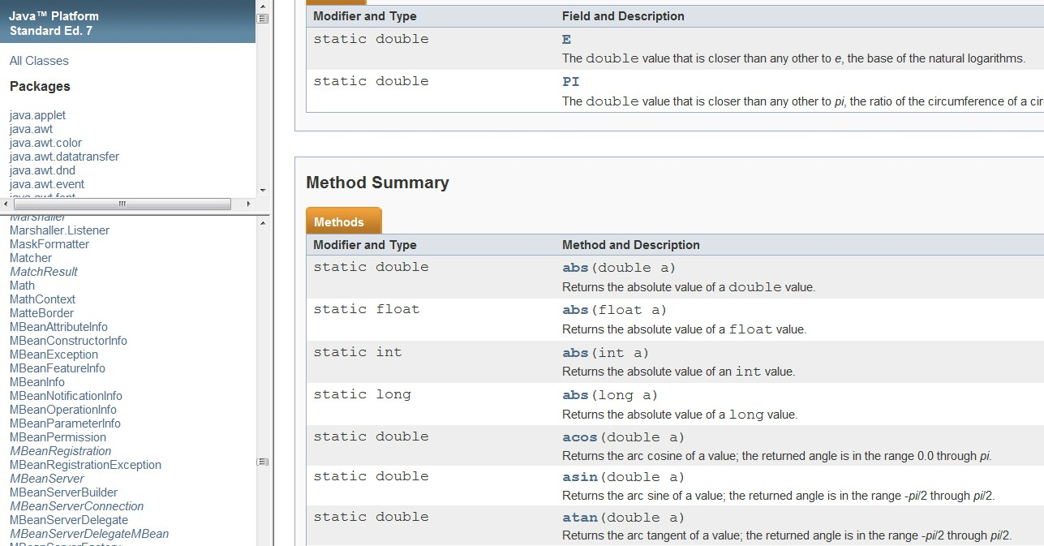
4.5 The Math class (1/2)
From the API documentation

Slide 50
4.5 The Math class (2/2)
Package: java.lang (default)
Some useful Math methods:
  abs()
  ceil()
  floor()
  max()
  min()
  pow()
  random()
  sqrt()

Slide 51
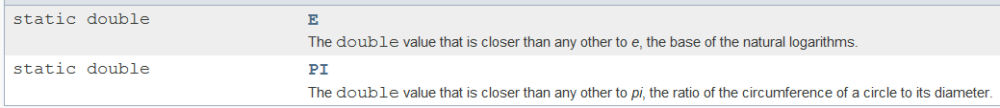
4.5 Class Attributes
The Math class has two class attributes
A class attribute (or class member) is associated with the class, not the individual instances (objects). Every instance of a class shares the class attribute.
  We will explain about “objects” later.
How to use it?
  Example:
double area = Math.PI * Math.pow(radius,2);
  Here, Math.PI is used as the constant π

Slide 52
4.5 The Math class: Demo
TestMath.java
// To find the area of the largest circle inscribed
// inside a square, given the area of the square.
import java.util.*;
public class TestMath {
radius
public static void main(String[] args) { Scanner sc = new Scanner(System.in);
System.out.print("Enter area of a square: "); double areaSquare = sc.nextDouble();
double radius = Math.sqrt(areaSquare)/2;
double areaCircle = Math.PI * Math.pow(radius, 2);
System.out.printf("Area of circle = %.4f\n",
areaCircle);
}
}

Slide 53
4.6 User-defined Functions
Reusable and independent code units

Slide 54
4.6 Function with a new name
In Java, C-like function is known as static/class method
  Denoted by the “static” keyword before return data type
  Another type of method, known as instance method will be covered later
public class Factorial {
Factorial.java
// Returns n!
// Pre-cond: n >= 0
public static int factorial (int n) { if (n == 0) return 1;
else return n * factorial(n-1);
}
If n is too big, say 40, what will happen? Why?
public static void main(String[] args) {
int n = 5; // You can change it to interactive input
System.out.printf("Factorial(%d) = %d\n", n, factorial(n));
}
}

Slide 55
4.6 Method Parameter Passing
All parameters in Java are passed by value (as in C):
  A copy of the actual argument is created upon method invocation
  The method parameter and its corresponding actual parameter are two independent variables
In order to let a method modify the actual argument:
  An object reference data type is needed (similar to pointer in C)
  Will be covered later

Slide 56
Summary
Data Types:
Numeric Data Types:
byte, short, int, float, double
Boolean Data Type: boolean
Expressions:
Arithmetic Expression
Boolean Expression
Control Flow Statements:
Selection Statements: if-else, switch-case
Repetition Statements: while, do-while, for
Classes:
Scanner
Math
Java Elements

Slide 57
Next Week: Real OOP
This week, the Java programs shown do not truly use object-oriented programming (OOP) features
We will learn some OOP concepts next week
[501043 Lecture 1: Intro to Java] 60

Slide 58
End of file

